Slide 1
Modeling Maturity and Fecundity in Stock Synthesis

Slide 2
Maturity
Several options to model maturity:
Logistic function of length
Logistic function of age
Input vector of maturity at each age
Input vector of fecundity at each age (ignore maturity)

Slide 3
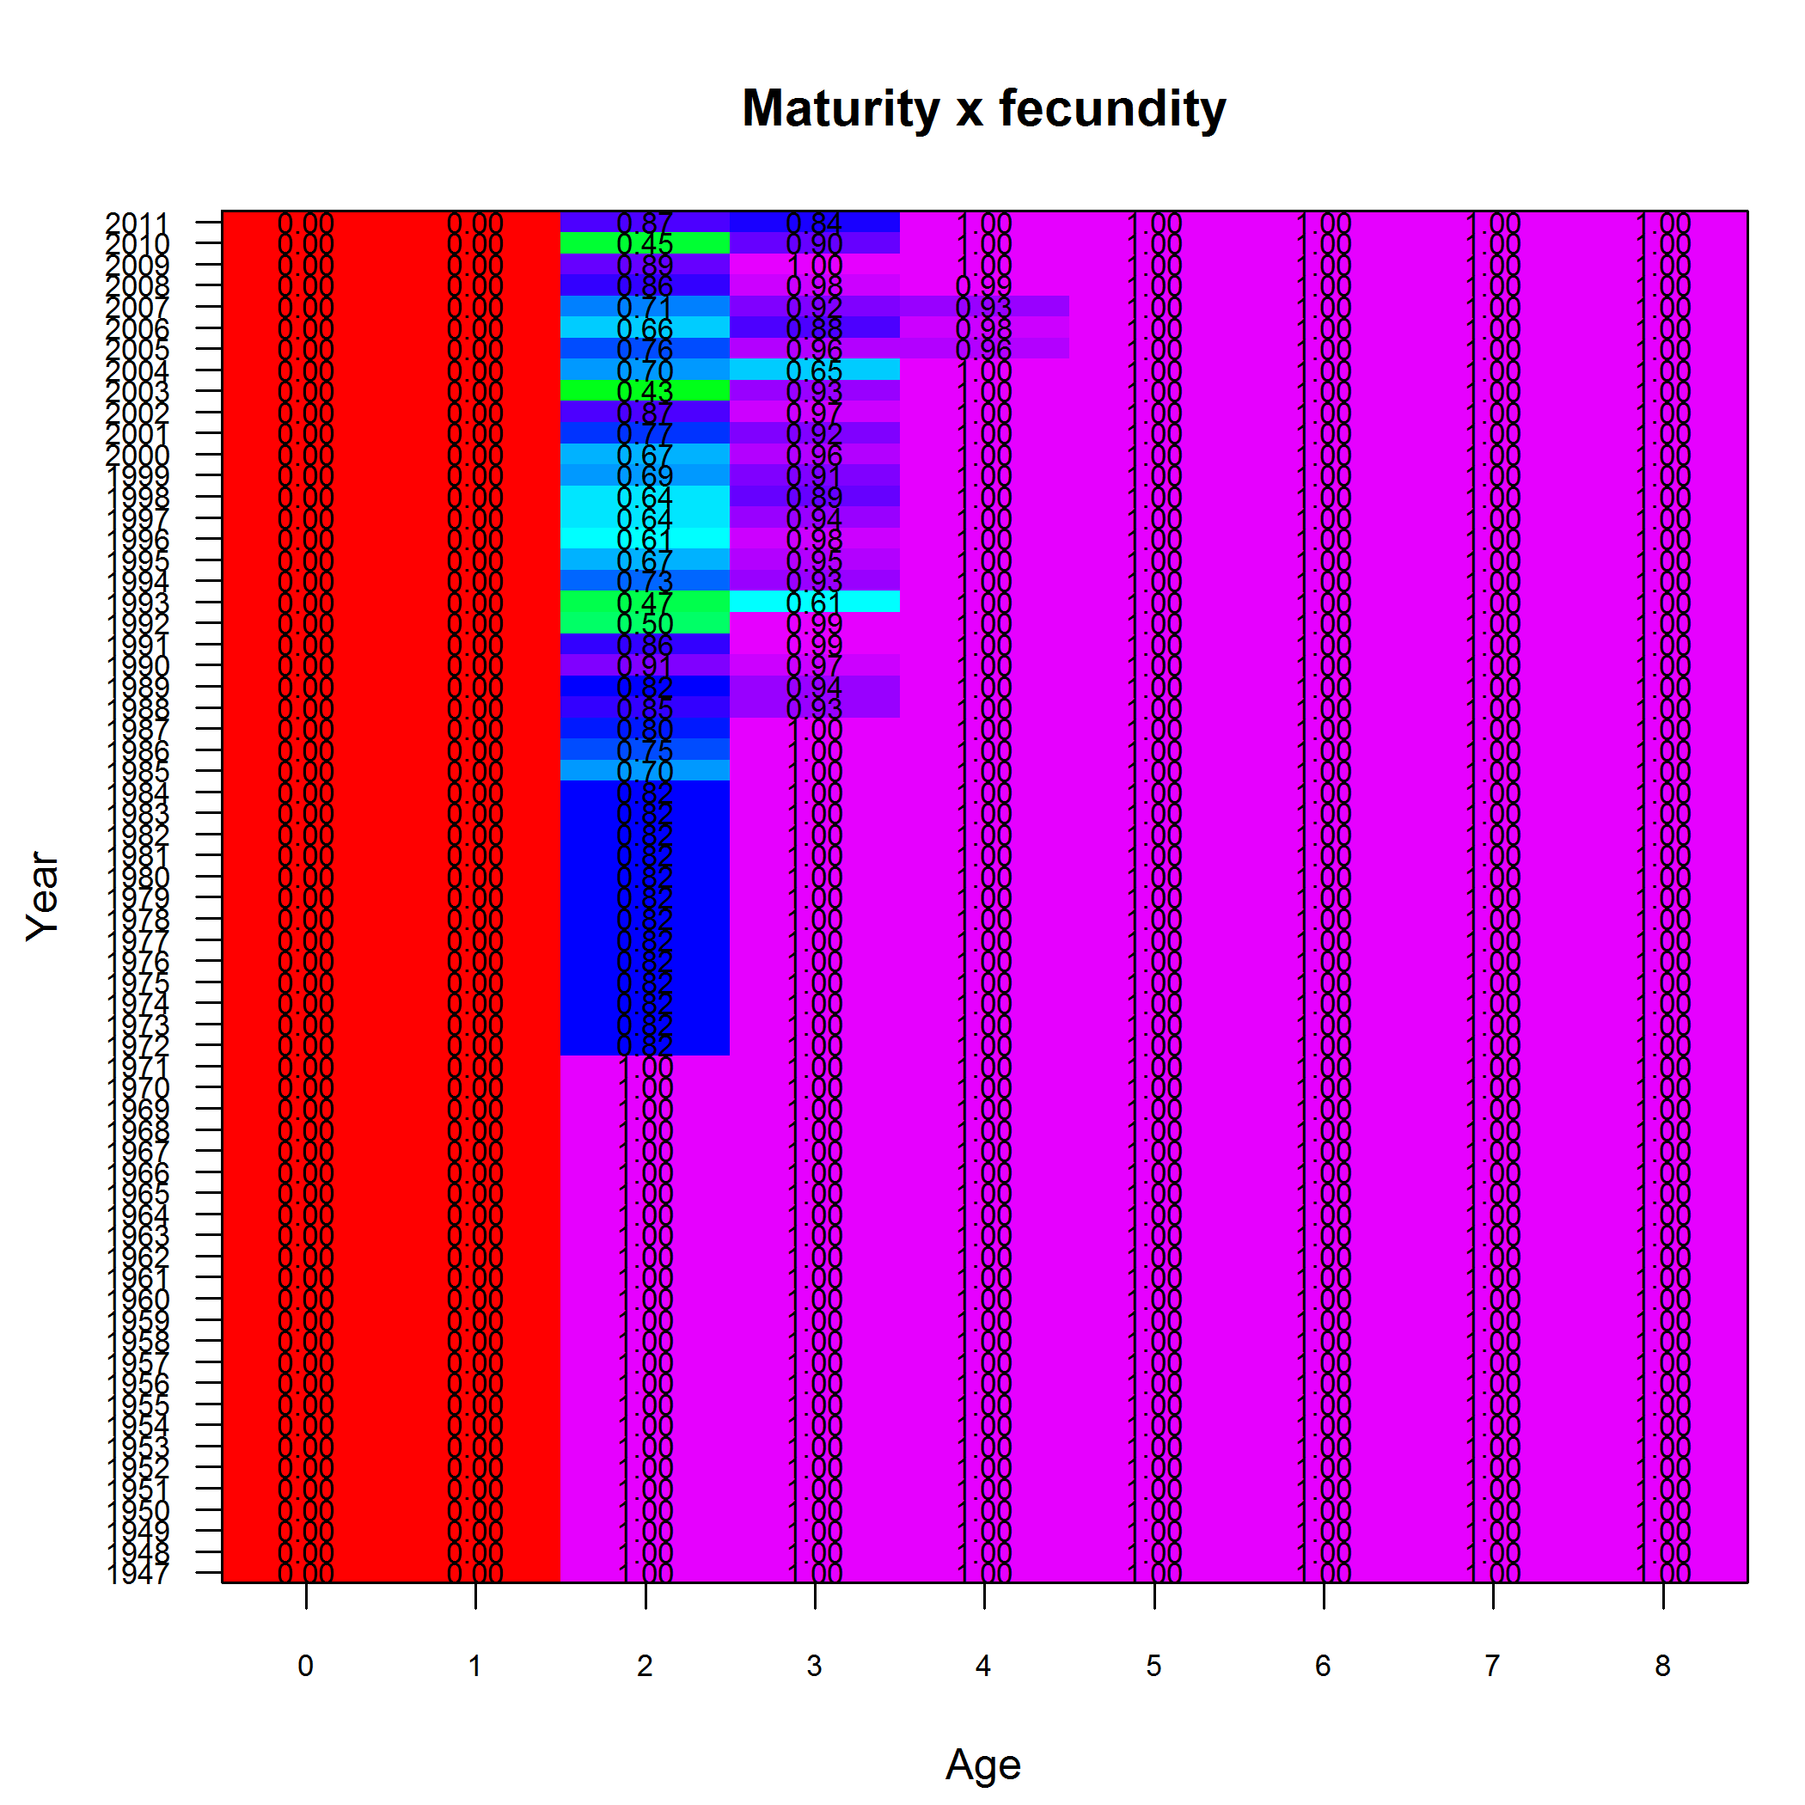
Empirical fecundity at age (NS Herring)

Slide 4
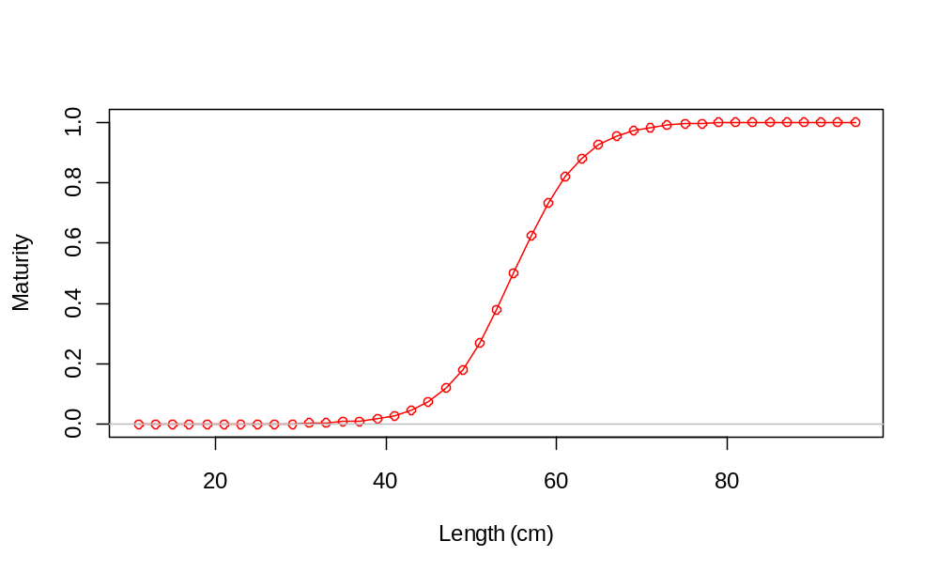
More on maturity
Parameters of logistic are length (or age) at 50% maturity and slope.
Extra input “first mature age” avoids youngest fish being mature, regardless of size

Slide 5
Fecundity
Several options to model fecundity:
Fixed vector of fecundity at age
Function of weight or length
  fecundity = W(a+bW)
  fecundity = aL^{b}
  fecundity = aW^{b}
Males can also be included in the calculation of spawning biomass
Hermaphroditism option available

Slide 6
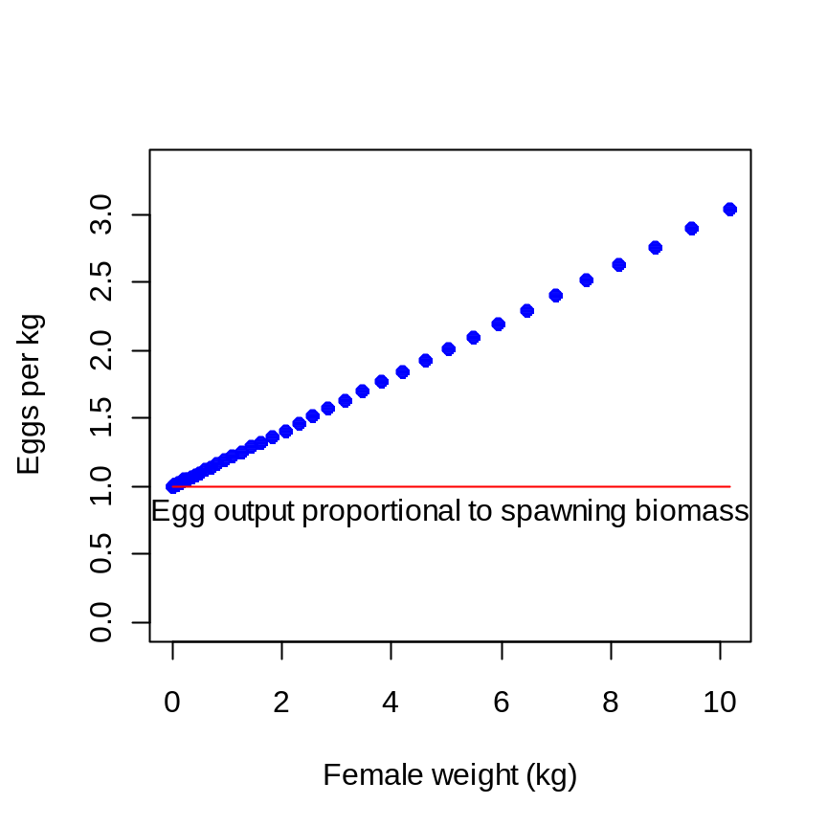
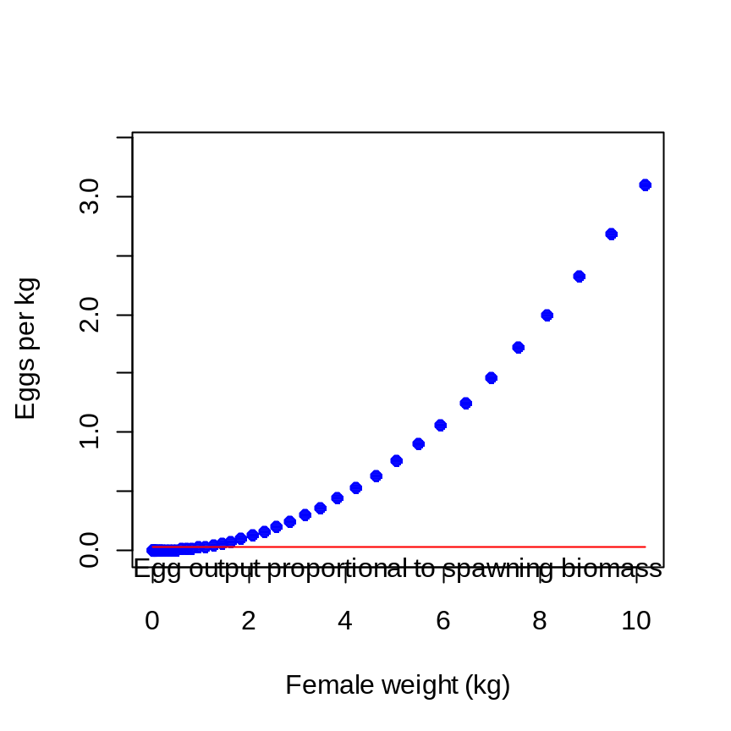
Fecundity
  fecundity = W(a+bW)
  fecundity = aW^{b}

Slide 7
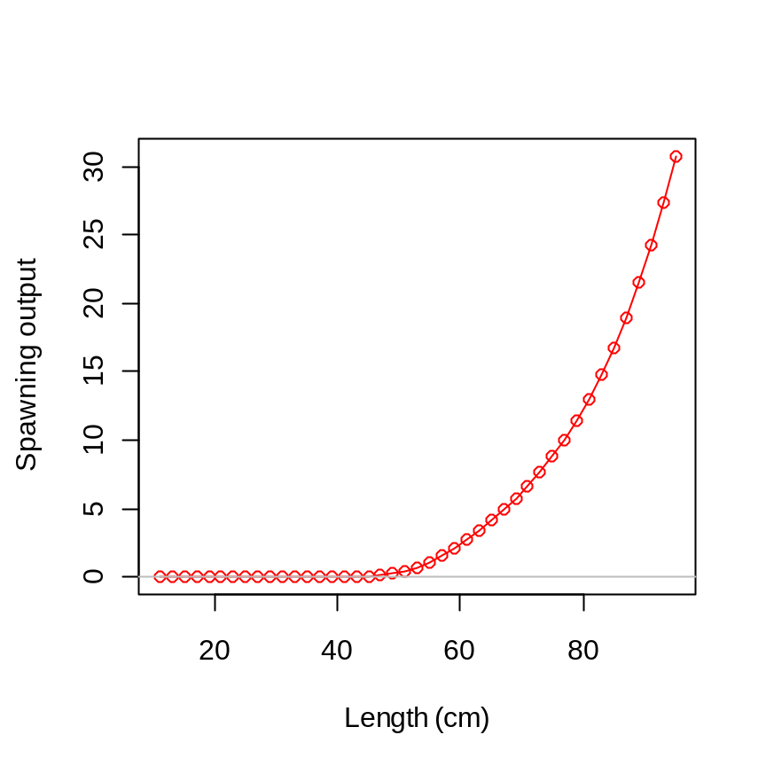
Spawning output
Maturity x Fecundity
Model tracks numbers at age,
but maturity, fecundity, and their product account for distribution
of length at each age

